Slide 1

Network+ Guide to Networks 6th Edition
Chapter 10
Virtual Networks and Remote Access

Slide 2
Objectives
Explain virtualization and identify characteristics of virtual network components
Create and configure virtual servers, adapters, and switches as part of a network
Describe techniques for incorporating virtual components in VLANs
Explain methods for remotely connecting to a network, including dial-up networking, virtual desktops, and thin clients

Slide 3
Objectives (cont’d.)
Discuss VPNs (virtual private networks) and the protocols they rely on
Identify the features and benefits of cloud computing and NaaS (Network as a Service)

Slide 4
Virtualization
Emulation of a computer, operating system environment, or application:
On a physical system
Virtual machines (VMs)
Virtual workstations
Virtual servers
Can be configured to use different types of:
CPU
Storage drive
NIC

Slide 5
Virtualization (cont’d.)
VM appears to user no different than physical computer:
Running the same software
Host
Physical computer
Guest
Virtual machines
Hypervisor
Manages virtual machines

Slide 6
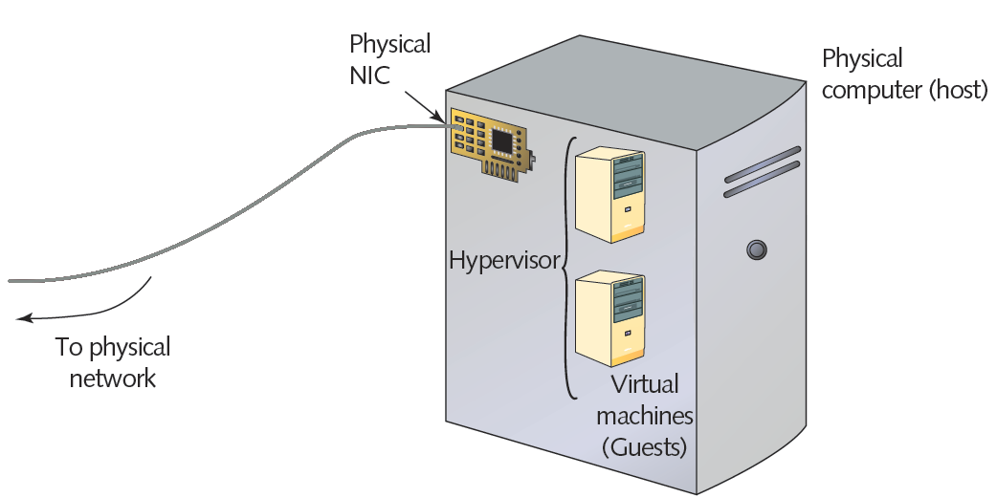
Figure 10-1 Elements of virtualization
Courtesy Course Technology/Cengage Learning

Slide 7
Virtualization (cont’d.)
Advantages of virtualization
Efficient use of resources
Cost and energy savings
Fault and threat isolation
Simple backups, recovery, and replication
Disadvantages
Compromised performance
Increased complexity
Increased licensing costs
Single point of failure

Slide 8
Virtual Network Components
Virtual network
Can be created to consist solely of virtual machines on a physical server
Most networks combine physical and virtual elements

Slide 9
Virtual Machines and Adapters
Virtualization program
Assigns VM’s software and hardware characteristics
Often easy to use, step-by-step wizard
Operating system images
Available for download online
Or on disc from software vendors
Network connection
Requires virtual adapter (vNIC)

Slide 10
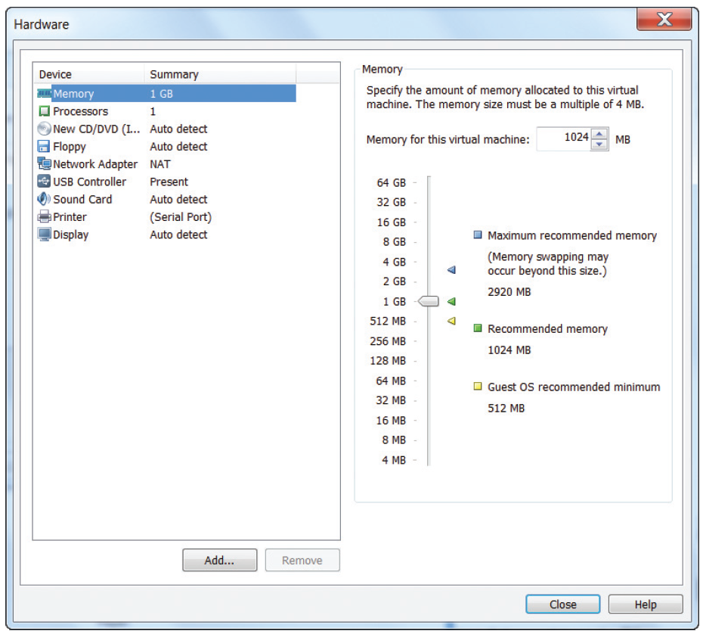
Figure 10-2 Specifying a VM’s memory in VMware
Courtesy Course Technology/Cengage Learning

Slide 11
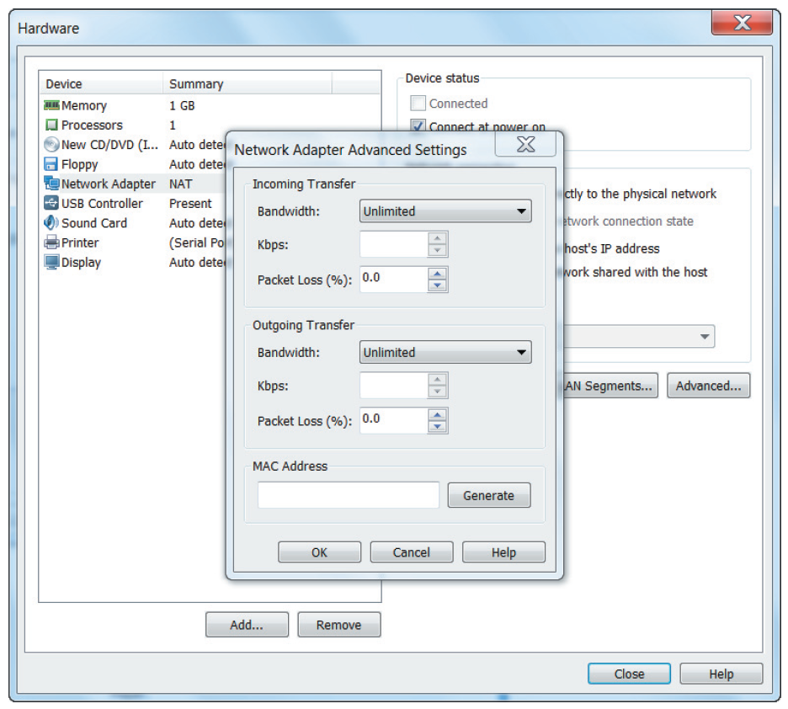
Figure 10-3 Customizing vNIC properties in VMware
Courtesy Course Technology/Cengage Learning

Slide 12
Virtual Switches and Bridges
Virtual bridge or switch
Created when first VM’s NIC is selected
Connects VM with host
Resides in RAM
Virtual switch
Logically defined device
Operates at Data Link layer
Passes frames between nodes
Virtual bridge
Connects vNICs with a network

Slide 13
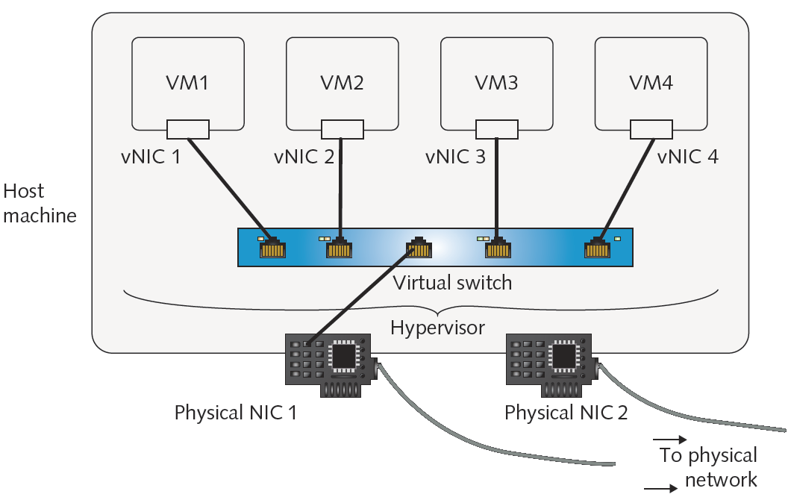
Figure 10-4 Virtual servers on a single host connected with a virtual switch
Courtesy Course Technology/Cengage Learning

Slide 14
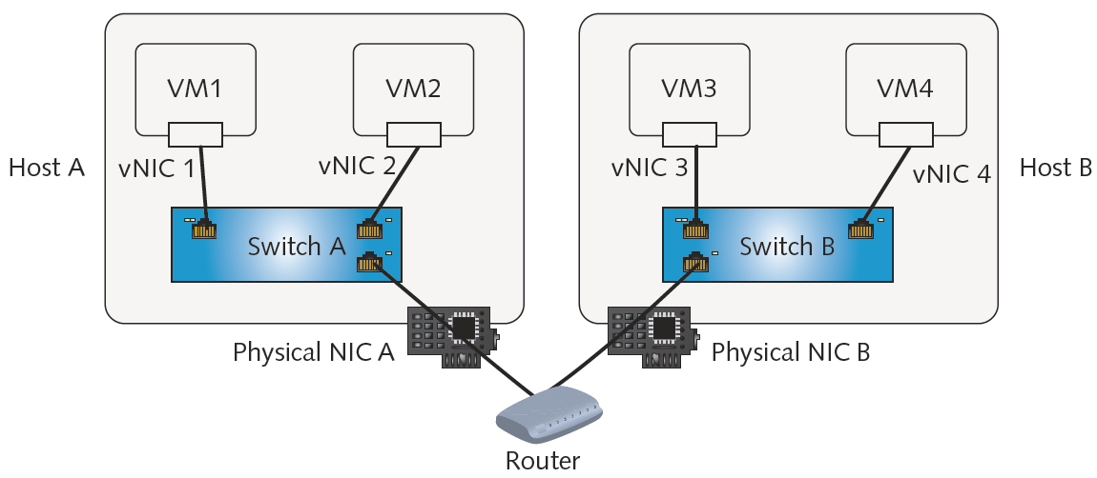
Figure 10-5 Virtual switches exchanging traffic through routers
Courtesy Course Technology/Cengage Learning

Slide 15
Network Connection Types
Must identify networking mode vNIC will use
Frequently-used network connection types
Bridged
NAT
Host-only
Bridged
vNIC accesses physical network using host machine’s NIC
Obtains own IP address, default gateway, and netmask from DHCP server on physical LAN

Slide 16
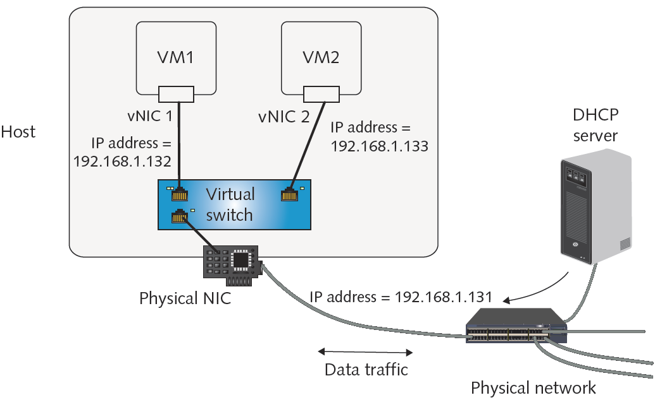
Figure 10-6 vNIC accessing a network in bridged mode
Courtesy Course Technology/Cengage Learning

Slide 17
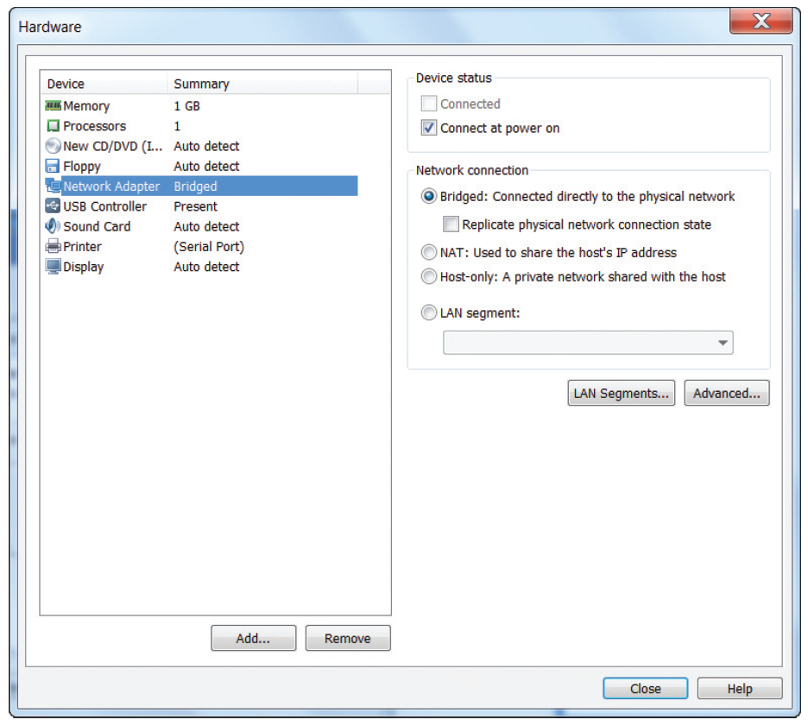
Figure 10-7 Selecting the Bridged option for a vNIC in VMware
Courtesy Course Technology/Cengage Learning

Slide 18
Network Connection Types (cont’d.)
NAT
vNIC relies on host to act as NAT device
Obtains IP addressing information from host
Virtualization software acts as a DHCP server
Default network connection type in VMware, VirtualBox, and KVM
Host-only
VMs on one host can exchange data with each other and the host
Cannot communicate with nodes beyond the host
Never receive or transmit data with host’s physical NIC

Slide 19
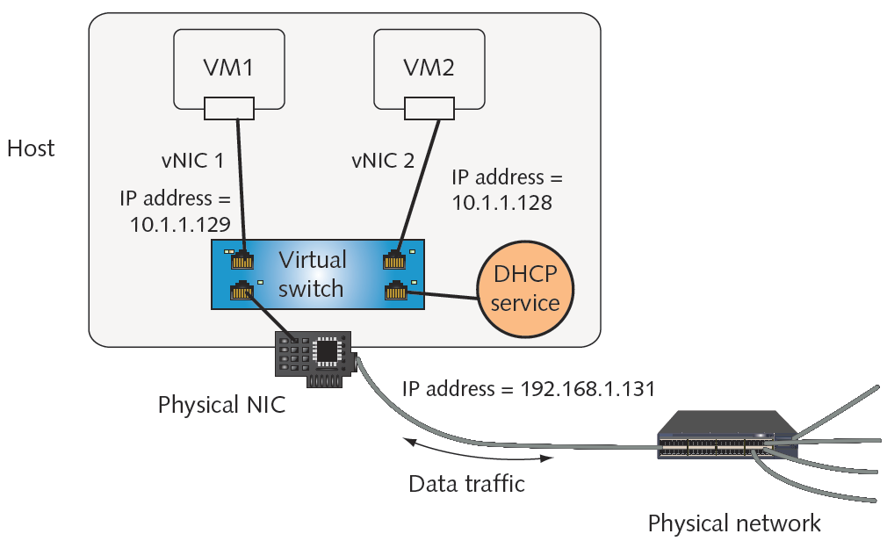
Figure 10-8 vNIC accessing a network in NAT mode
Courtesy Course Technology/Cengage Learning

Slide 20
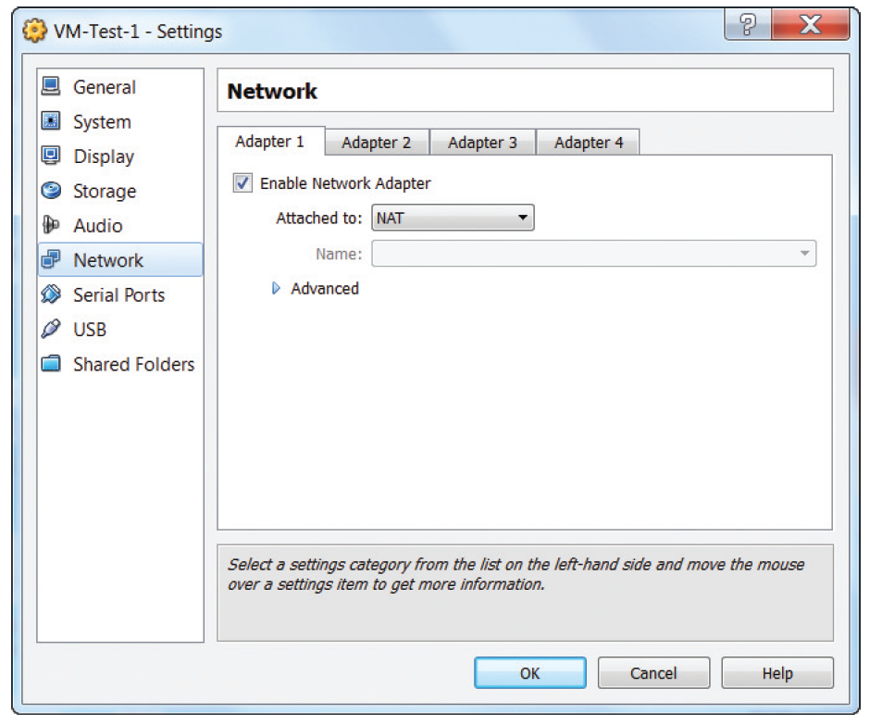
Figure 10-9 Selecting the NAT option for a vNIC in VirtualBox
Courtesy Course Technology/Cengage Learning

Slide 21
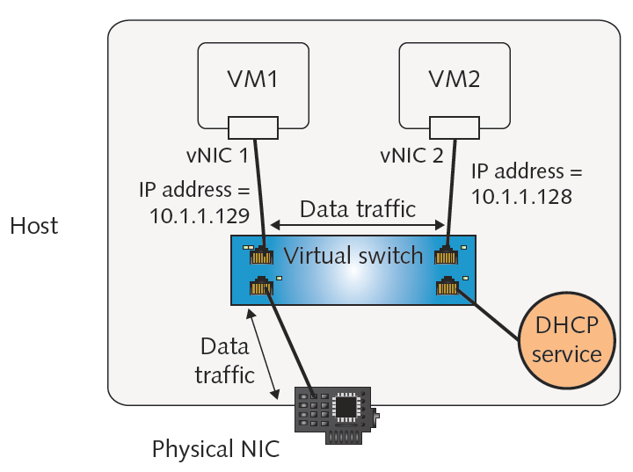
Figure 10-10 Host-only network configuration
Courtesy Course Technology/Cengage Learning

Slide 22
Virtual Appliances
Alternative to test servers for new software
Virtual appliance includes:
Image of operating system, software, hardware specifications, and application configuration
Most commonly virtual servers
Popular functions
Firewall
E-mail solutions
Network management
Remote access

Slide 23
Virtual Networks and VLANs
Virtual network
Refers to how VMs connect with other virtual and physical network nodes
Virtual network management
Nearly identical to physical network management
To add VMs to a physical VLAN:
Modify virtual switch’s configuration
Steps vary for different virtualization programs

Slide 24
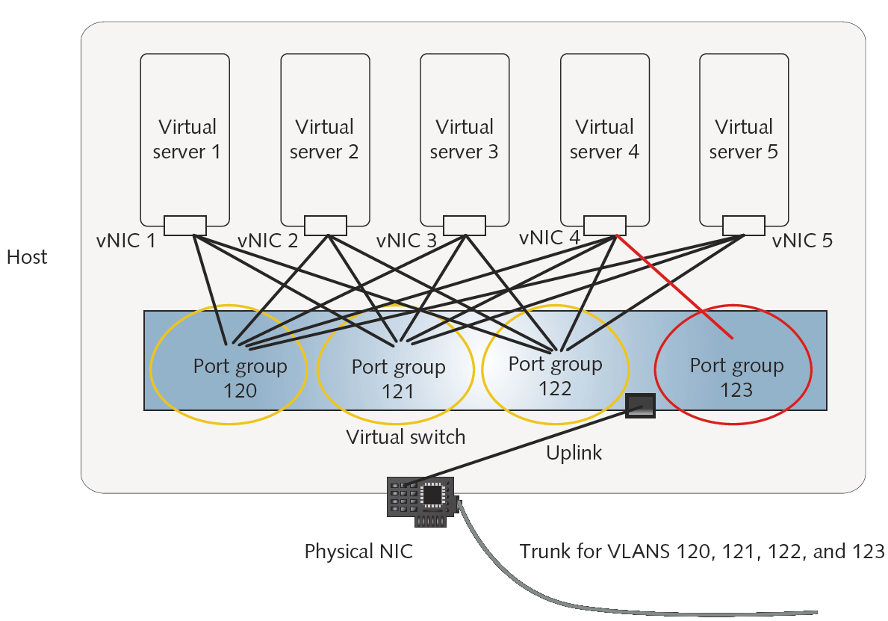
Figure 10-11 Multiple virtual servers connected to multiple VLANs
Courtesy Course Technology/Cengage Learning

Slide 25
Remote Access and Virtual Computing
Remote access
Allows user to connect with LAN or WAN in different geographical location
Allows access to shared resources as any other client on LAN or WAN
Requires transmission path and appropriate software
Popular remote access techniques
Dial-up networking
Microsoft’s Remote Access Service (RAS)
Or Routing and Remote Access Service (RRAS)
Virtual Private Networks

Slide 26
Dial-Up Networking
Dialing directly into private network’s or ISP’s remote access server
Usually refers to connection using PSTN
Remote access server attached to group of modems
Client must run dial-up software
After authentication, user allowed access
Remote access server can serve multiple users
Low throughput
Less popular today
Public Switched Telephone Network

Slide 27
Remote Access Servers
Accepts connections regardless of Internet connection type
RRAS (Routing and Remote Access Service)
Microsoft’s remote access software
Available with Server 2003, 2008, 2008 R2, XP, Vista, and 7 operating systems
Enables server to act as a router
Includes multiple security provisions

Slide 28
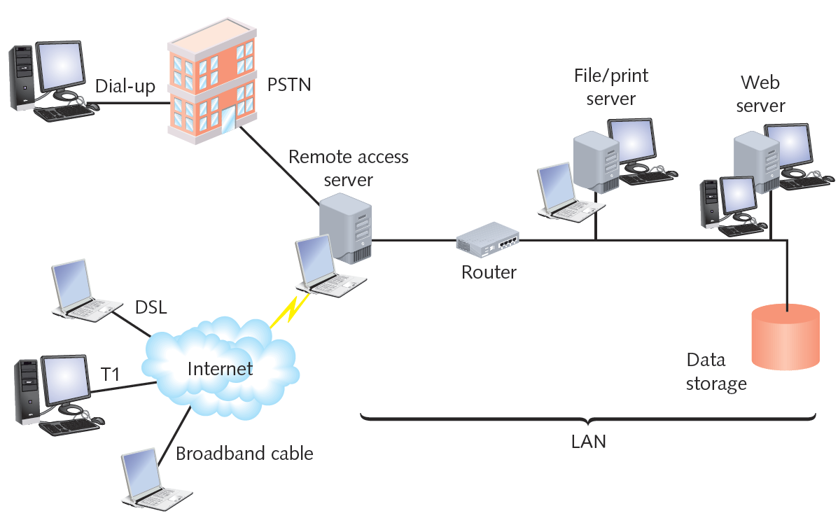
Figure 10-12 Clients connecting with a remote access server
Courtesy Course Technology/Cengage Learning

Slide 29
Remote Access Protocols
SLIP (Serial Line Internet Protocol)
Earlier and less sophisticated than PPP
Can only carry IP packets
Requires significant amount of setup
Does not support data encryption
Asynchronous transmission
PPP (Point-to-Point Protocol)
Known as PPPoE when used over Ethernet
Standard for connecting home computers to ISP
Via DSL or broadband cable

Slide 30
Remote Virtual Computing
Allows workstation to remotely access and control another workstation
Host may allow clients a variety of privileges
Can send keystrokes and mouse clicks to the host
Receive screen output in return
Thin client
Workstation that uses such software to access LAN
Requires very little hard disk space or processing power

Slide 31
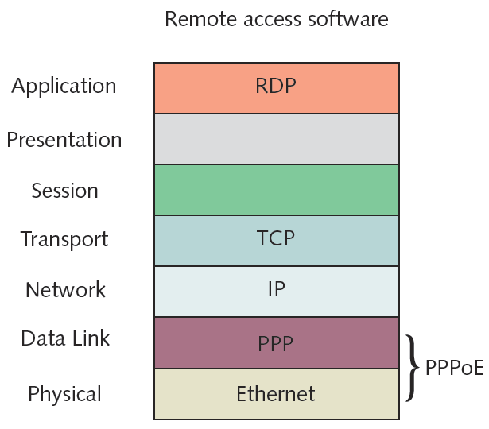
Figure 10-13 Protocols used in a remote access Internet connection
Courtesy Course Technology/Cengage Learning

Slide 32
Remote Virtual Computing (cont’d.)
Advantages
Simple to configure
Runs over any connection type
Single host can accept simultaneous connections from multiple clients
Popular programs
Microsoft Remote Desktop
VNC (Virtual Network Computing)
ICA (Independent Computing Architecture)

Slide 33
Remote Virtual Computing (cont’d.)
Remote desktop
Comes with Windows client and server operating systems
VNC (Virtual Network Computing)
Open source system
ICA (Independent Computing Architecture)
Citrix System’s XenApp
Can work with virtually any operating system or application
Easy to use

Slide 34
VPNs (Virtual Private Networks)
Logically defined networks over public transmission systems
Isolated from other traffic on same public lines
Requires inexpensive software
Important considerations
Interoperability
Security
Types
Site-to-site
Client-to-site

Slide 35
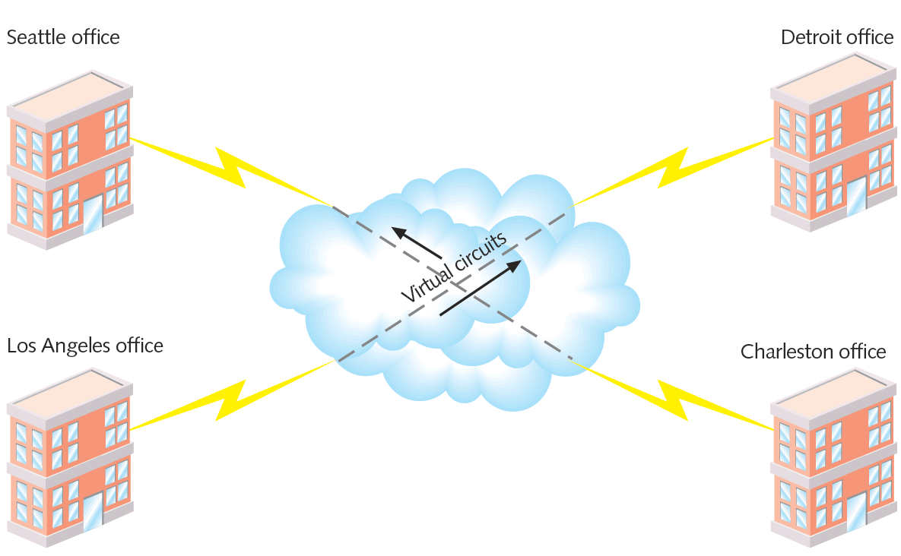
Figure 10-14 Site-to-site VPN
Courtesy Course Technology/Cengage Learning

Slide 36
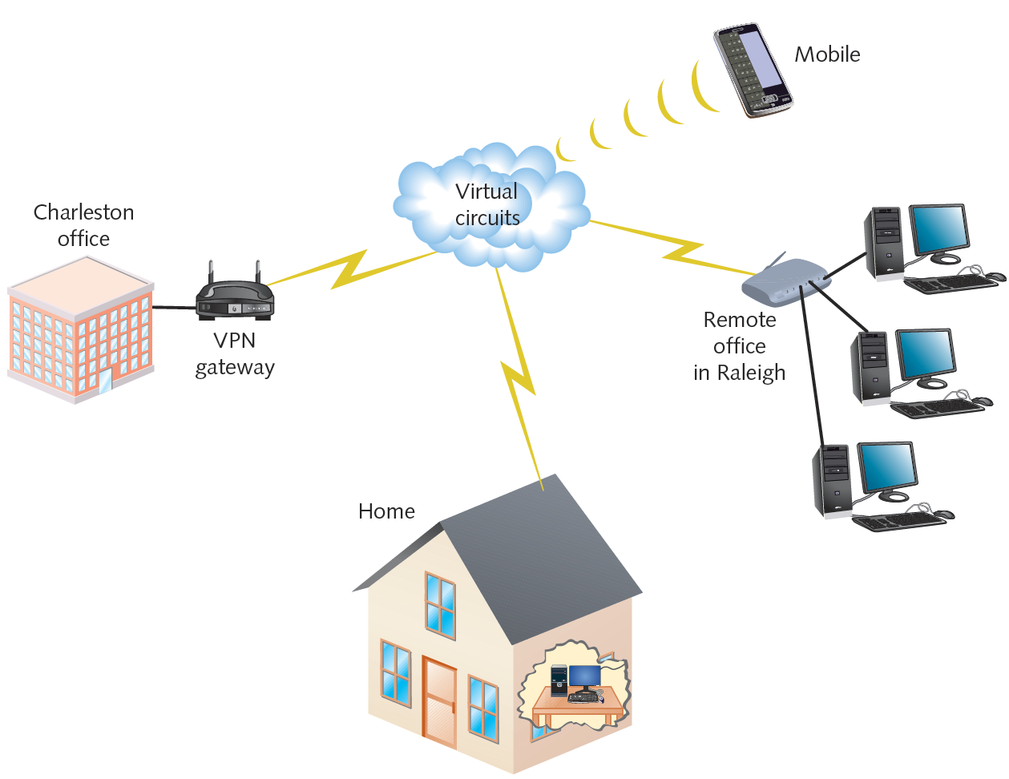
Figure 10-15 Client-to-site VPN
Courtesy Course Technology/Cengage Learning

Slide 37
VPNs (cont’d.)
Enterprise-wide VPN
Can include elements of client-to-site and site-to-site models
VPNs tailored to customer’s distance, user, and bandwidth needs
Two major types of tunneling protocols
PPTP (Point-to-Point Tunneling Protocol)
L2TP (Layer 2 Tunneling Protocol)

Slide 38
Cloud Computing
Internet frequently pictured as a cloud
Cloud computing
Flexible provision of data storage, applications, and services
To multiple clients over a network
Cloud computing distinguishing features
Self-service and on-demand
Elastic
Supports multiple platforms
Resource pooling and consolidation
Metered service

Slide 39
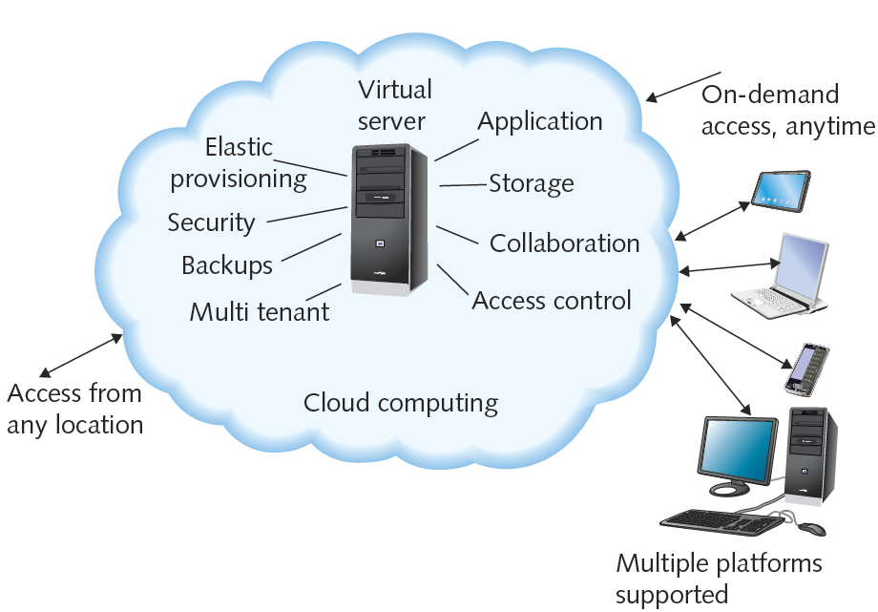
Figure 10-16 Example of cloud computing
Courtesy Course Technology/Cengage Learning

Slide 40
Cloud Computing (cont’d.)
Can provide virtual desktops
Operating environments hosted virtually
Different physical computer than one user interacts with
NaaS (Network as a Service)
Service provider offers customers complete set of networking services
Types of delivery
Public cloud
Private cloud

Slide 41
Summary
Virtualization: emulation of a computer, operating system environment, or application on a physical system
VMs exist as files on physical computer’s hard disk
Hypervisor software manages resource allocation and sharing among virtual machines
Virtual switch allows VMs to communicate with each other and with nodes on a physical LAN or WAN
Different methods of remote user access exist
Cloud computing provides storage, applications, or services over a network

